Slide 1
Lab meeting
12/11/2024

Slide 2
Aim
Investigate differences between FDI and BCP in three decision processes using signals (SSVEP, CPP, MB).
Examine differences in decision processes during learning (FDI vs. BCP)
Explore the relationship between EMG onset time (EOL) and response lock (RL)
Hypothesize findings in partial bursts Lock (PBL) for signals/ signal trial

Slide 3
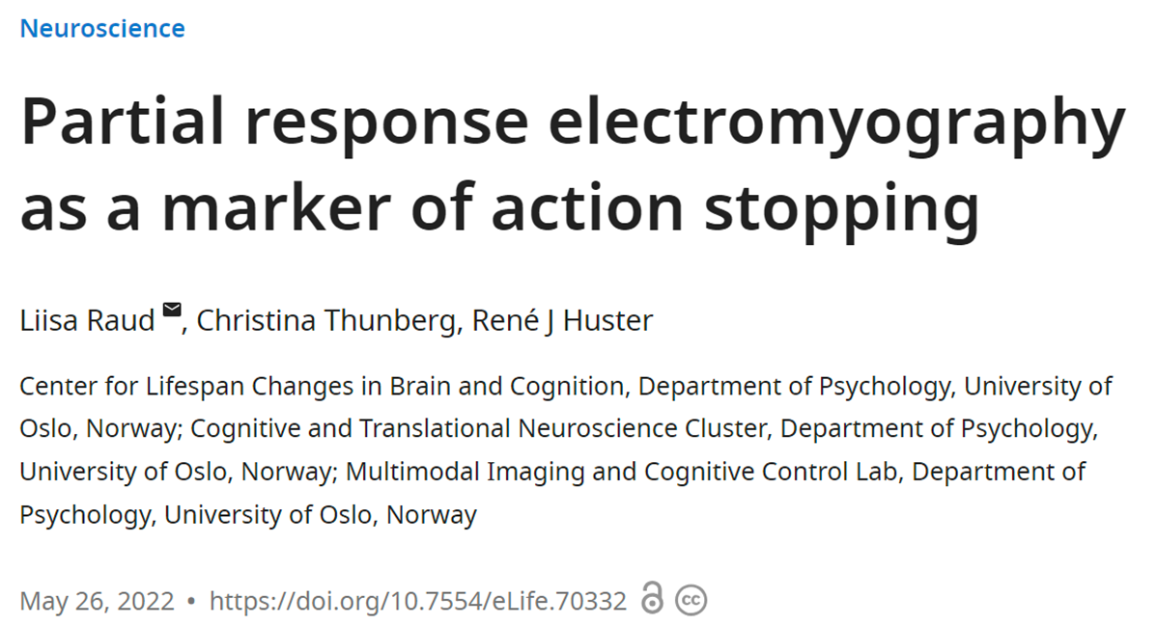
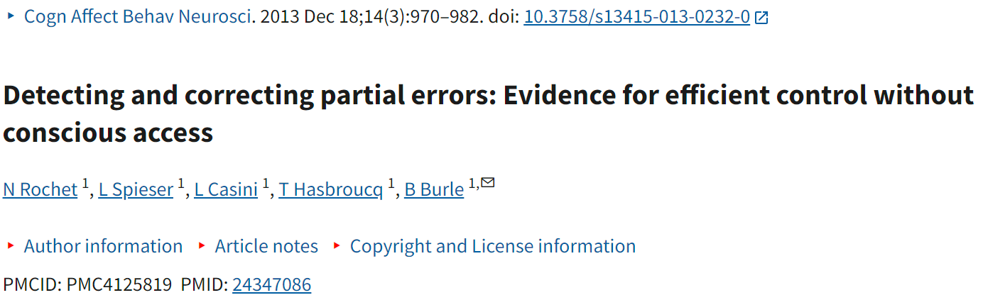
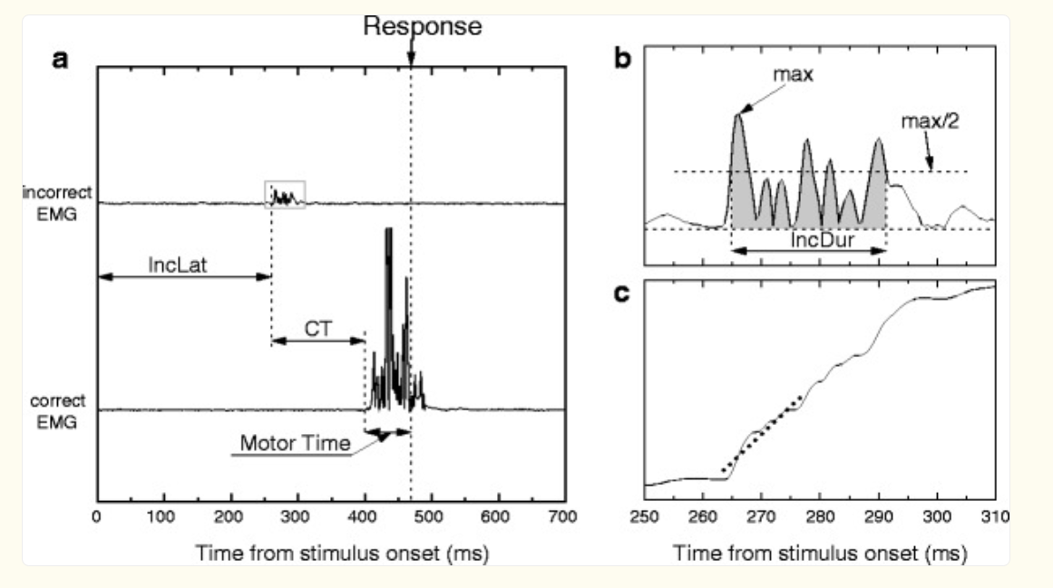
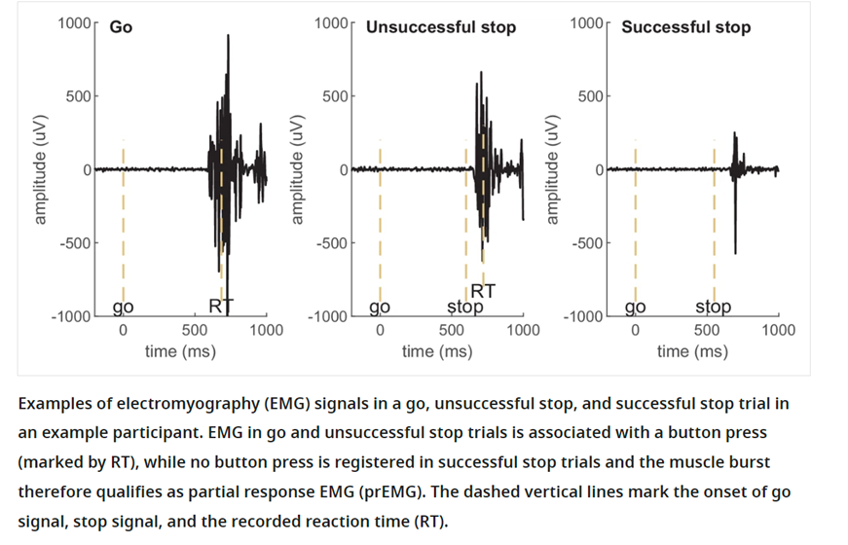



Partial response ! = Partial burst/ errors
in the present study, we showed that, unlike overt errors, such “partial errors” are poorly consciously detected by participants, who could report only one third of their partial errors.
! =

Slide 4
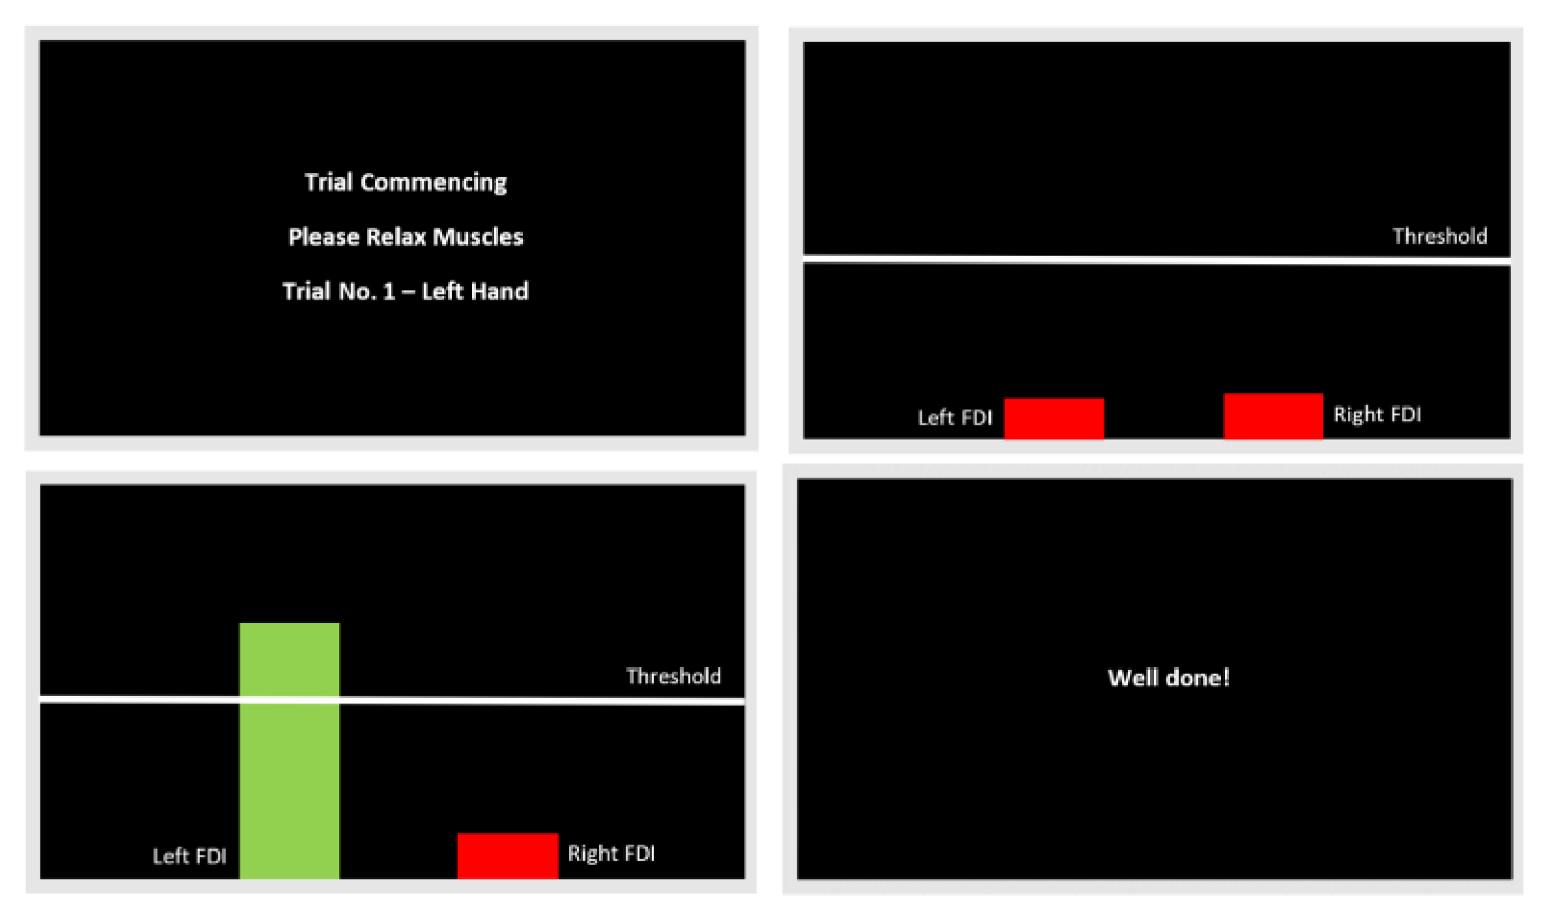

New Pilot Experiment Setup (n=6)
Standardized Response Action
Position Change: Adjusted from P4.
Force Control Training
Established minimum response threshold (10%).
Task Training
Difficulty level decrease from 0.4 to 0.07 (based on accuracy).
Calibration
Delayed feedback implemented before each block.
Training section (real-time feedback)
10 min EMG calibration
15 min for force control training
20 min for contrast discrimination task learning

Slide 5
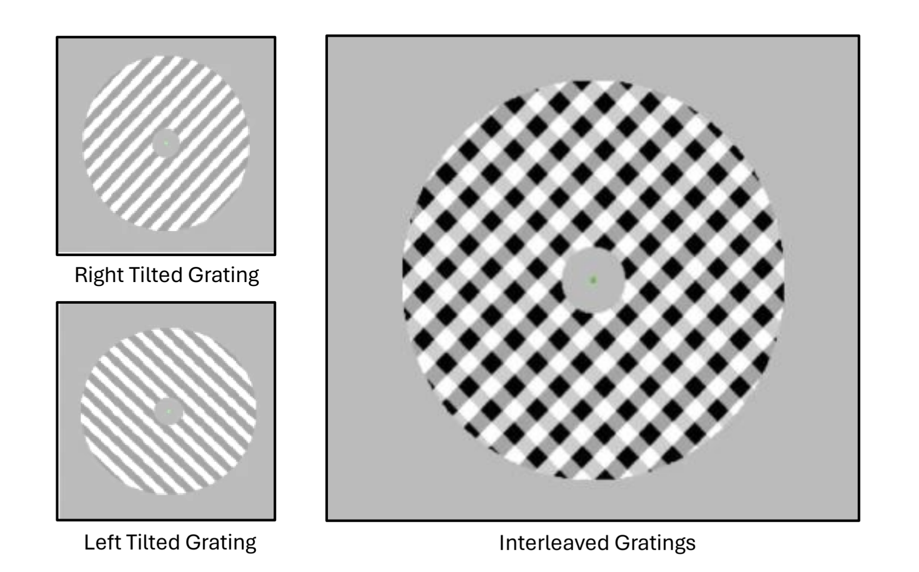
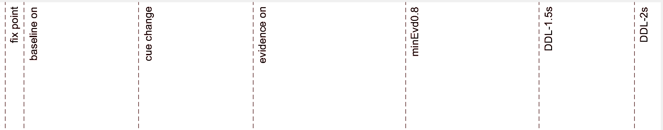
2 coherence level – easy (0.1) and hard (0.05)
3s DDL
1.8s late warning
0.2s early warning
0.2s evidence delay
EVon
0.8s – 3s
RT
0.2s – 1.8s
0.2s
EVoff
0.1s
0.6s
0.6s
0.8s
1s
1.2s

Slide 6
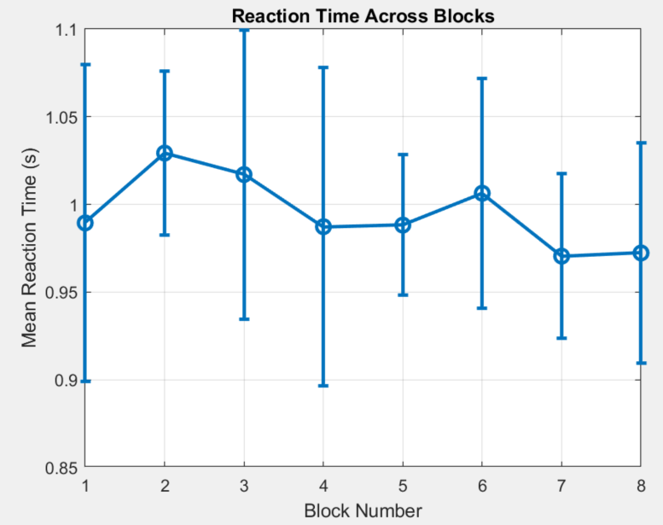
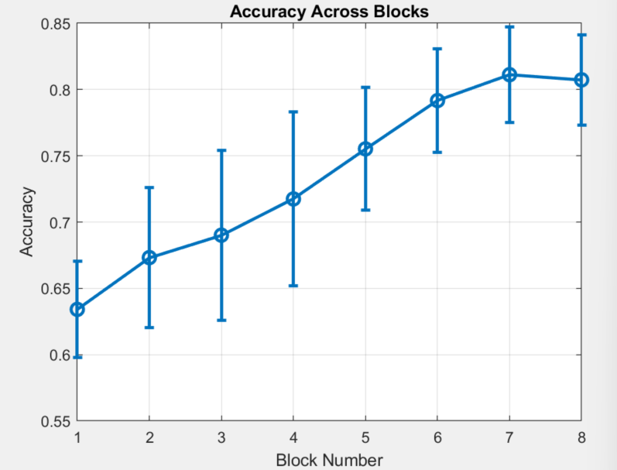
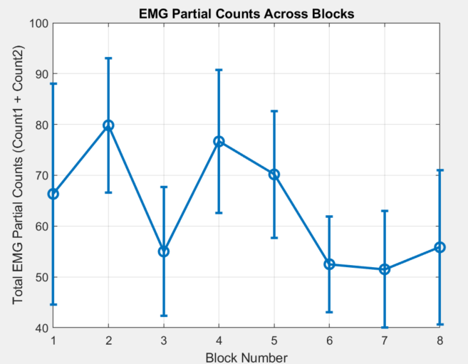
Learning
Accuracy: Increased after learning.
Reaction Time (RT): Decreased after learning.
Partial Bursts: Reduced after learning.

Slide 7
FDI BCP differents
FDI: Faster reaction times (RT = EMG onset + MT)
FDI: Faster decision time (EMG onset).
BCP: Faster movement time (MT).
BCP: No partial bursts observed.
Learning: Greater in FDI. Occurs primarily in movement time (MT), with some in FDI decision time (from acc aprove).
RT Variation: Smaller changes between trials.

Slide 8
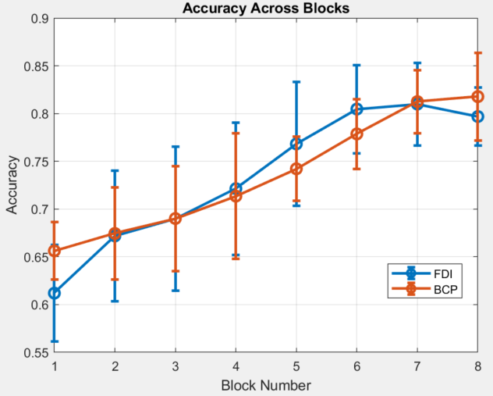
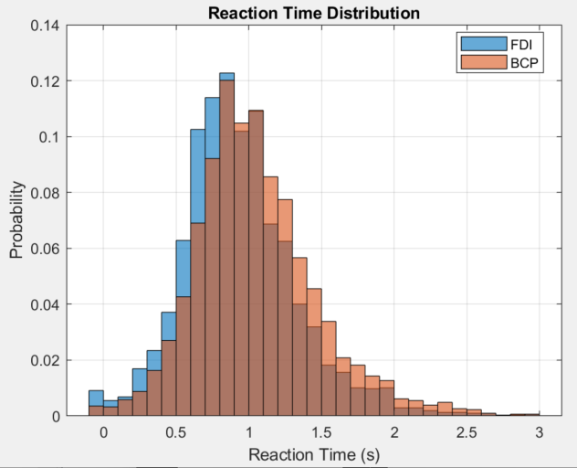
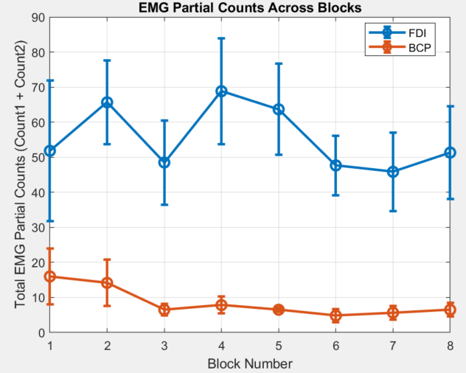
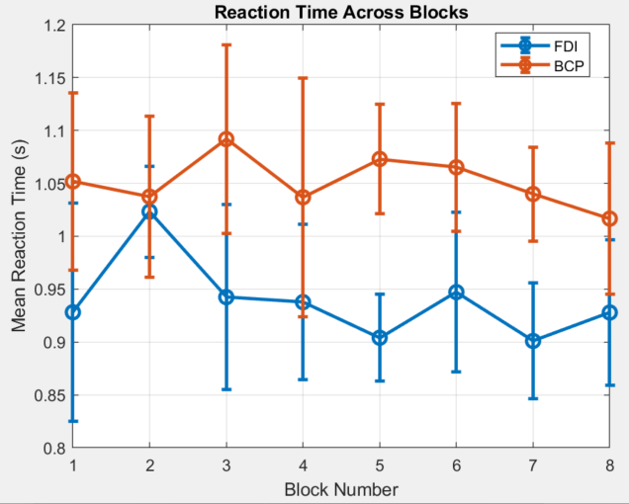

Slide 9
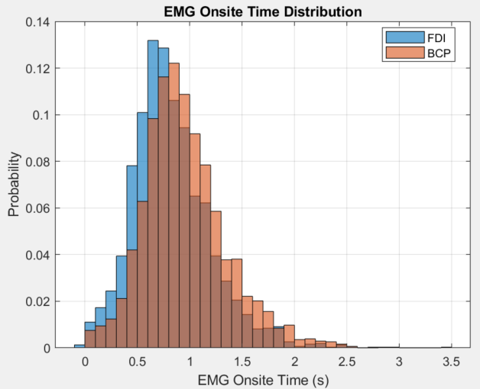
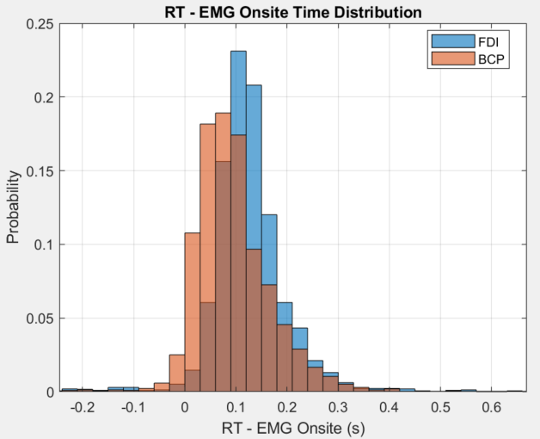
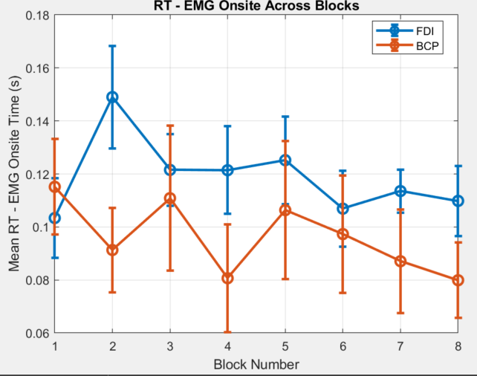
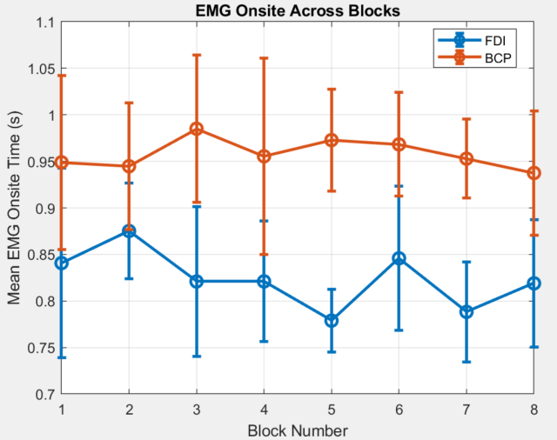


Slide 10
BCP higher starting acc because high attention (they know BCP will be harder at start)

Slide 11
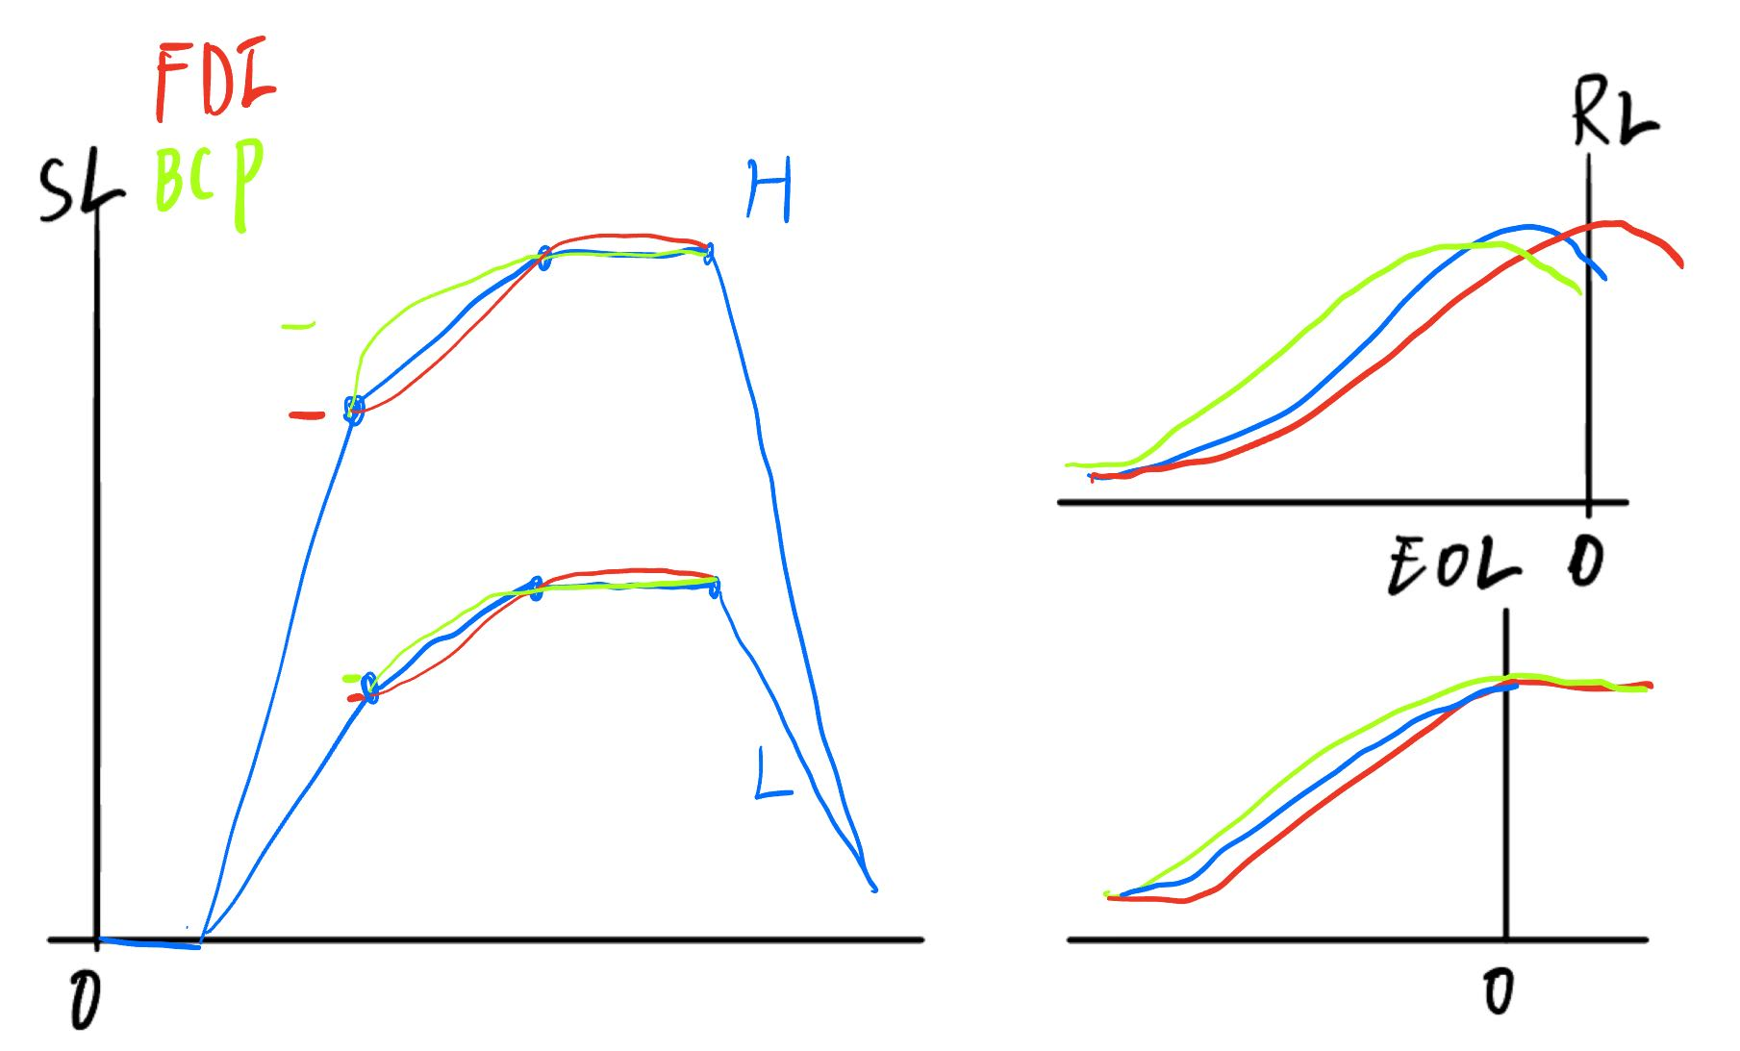
SSVEP hypo
? 18.75 and 21.25 why
Increase stage1 (H/L diff) – increase stage 2 (attention diff) – stable/decision stage (feed back/ Com)- decrease stage (H/L diff)
For error choose (dash), amplitude will decrease very fast
Increased Attention: Focus higher on difficult tasks (BCP high initially because of prior).
FDI vs. BCP: Differences more pronounced in H tasks.

Slide 12
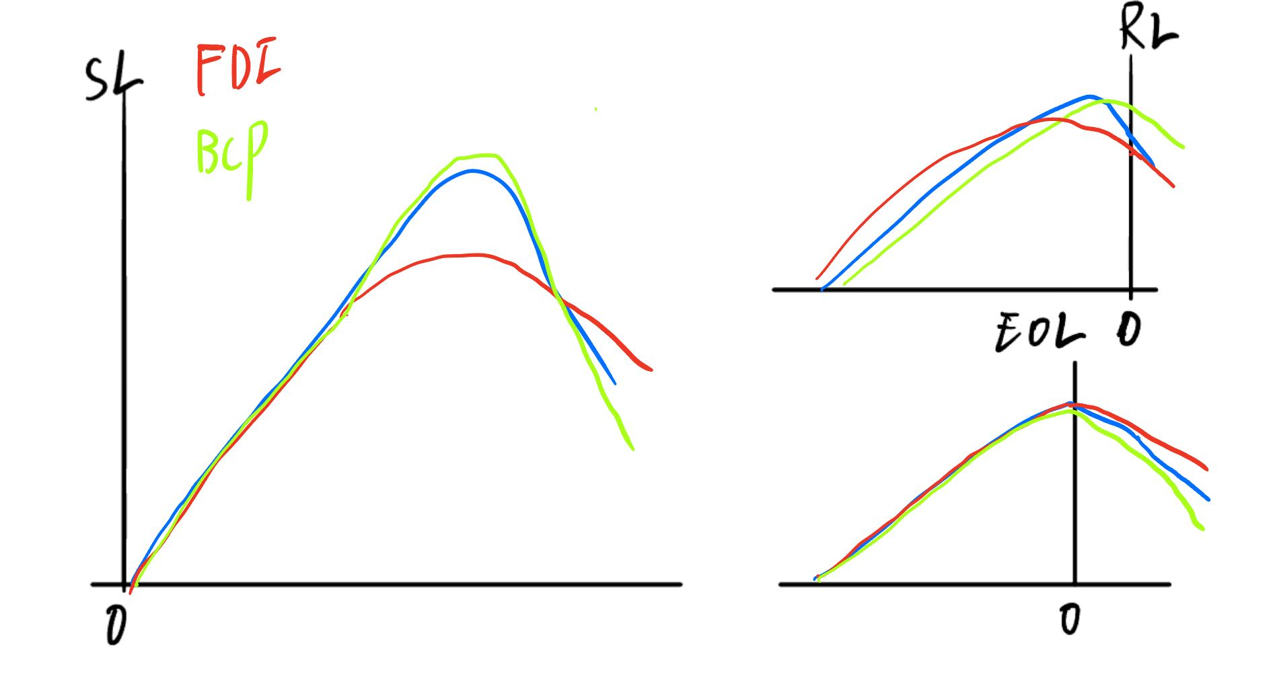
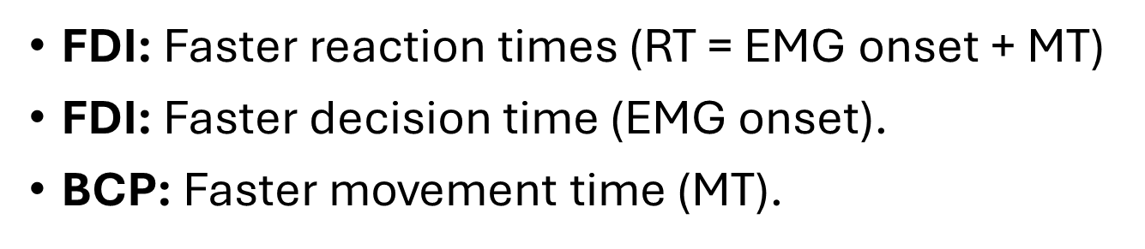
CPP
Amplitude: BCP larger (no feedback to impress accuracy)
Slope: same / FDI slightly higher (more connection); shows diff mainly in motor period)
(same) FDI faster decision time because action start when making decision

Slide 13


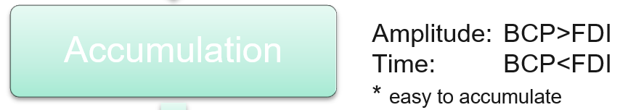







Notes:
这是FDIBCP区别展示
SL：斜率不同，BCP阈值更高（假设为线性模型）
RT: BCP斜率更大，所以FDI更快； 但是这种差异是MT不同导致的（整体后移）
EOL: BCP有更快的RT(为证明其中加快是来自MT or PMT),需要EoL，（证明差异大部分来自MT,EOL后斜率不同）
结合行为数据与EOL，似乎BCP更快的RT来源于MT（EMG onsite后的斜率差异， 可能PMT中仍存在（有一种假设是按比例减少），需要更大数据集

Slide 14
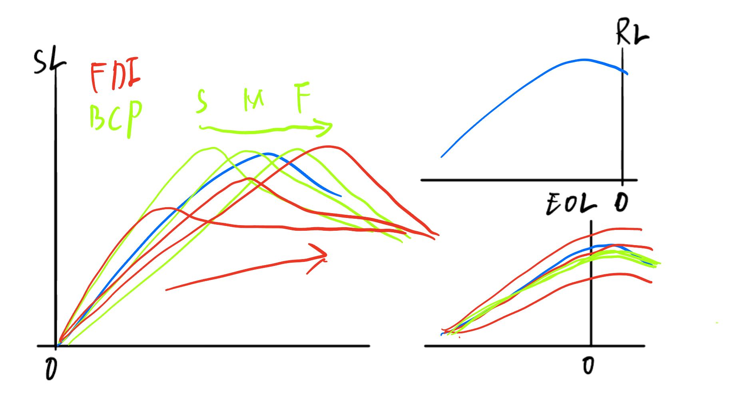
MB
FDI have different MB pattern
BCP have same MB pattern
Left/ right prior baise? (guess left and correct becomes fast)
BCP less connection: MB may be more dispersed, start anytime, and last shorter (less MT); amplitude lower

Slide 15
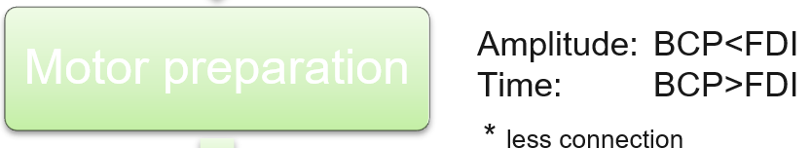
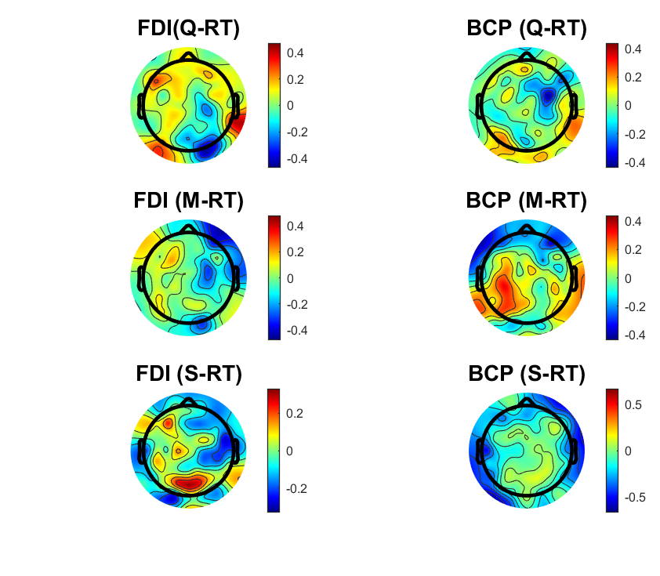
Notes:
暗示这里因为左右手的prior造成cue on 后时间差异， 红色为prior对了，绿色为prior错了导致慢
FDI 从cue开始不同，且斜率不同，峰值不同
BCP斜率相似，峰值相同，更像线性模型向后平移触发

Slide 16
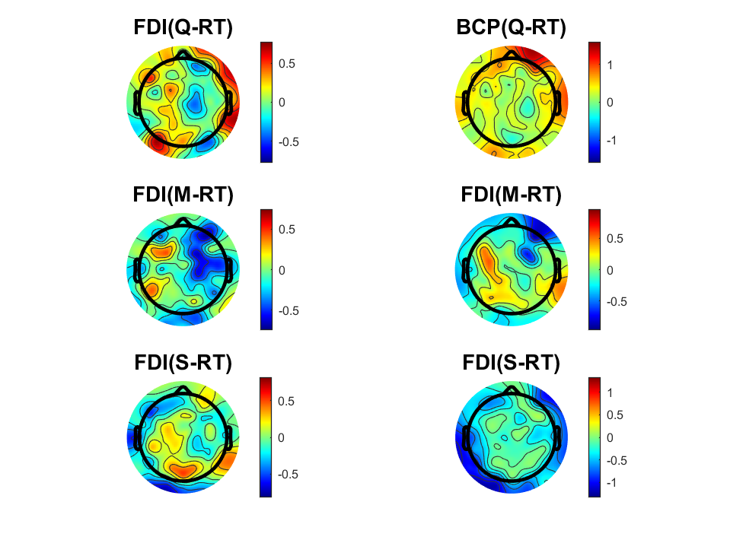
Notes:
上面是RL，下面是EOL
明显看出更新后 FDI 斜率不同，饱和点不同
BCP斜率相同，饱和点相同（暗示BCP的MP是相同模式的）

Slide 17
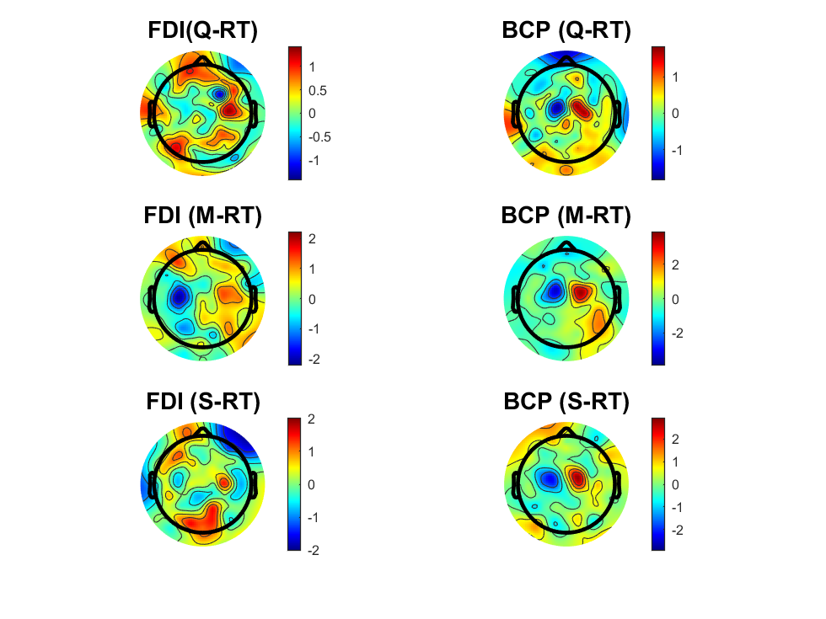
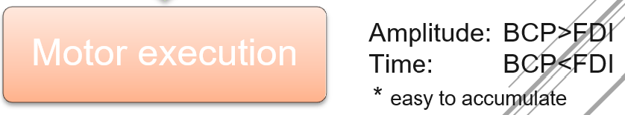
LRP-delta
How much does changing action affect the scalp plot?
SL: BCP more action cost – larger amplitude
EOL: FDI turning point earlier – more precise control
Notes:
且BCP明显靠里
观察到了不同的斜率和饱和点 （BCP less control, easy overshooting）

Slide 18
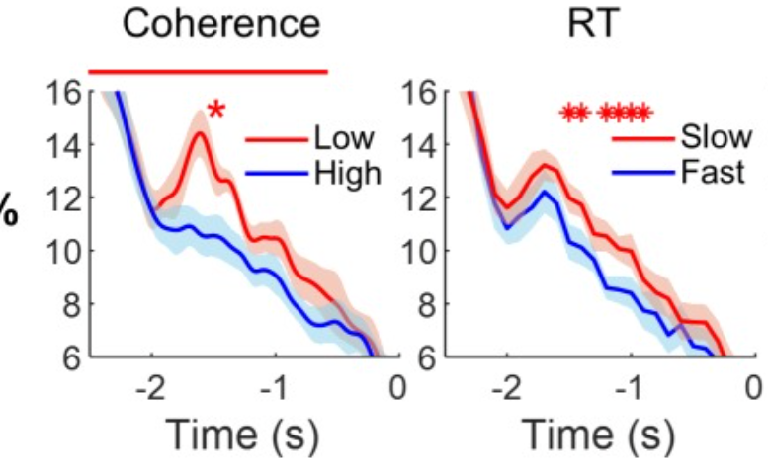
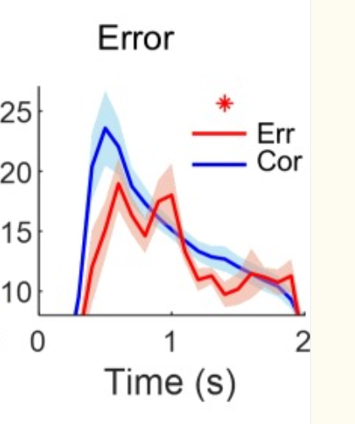
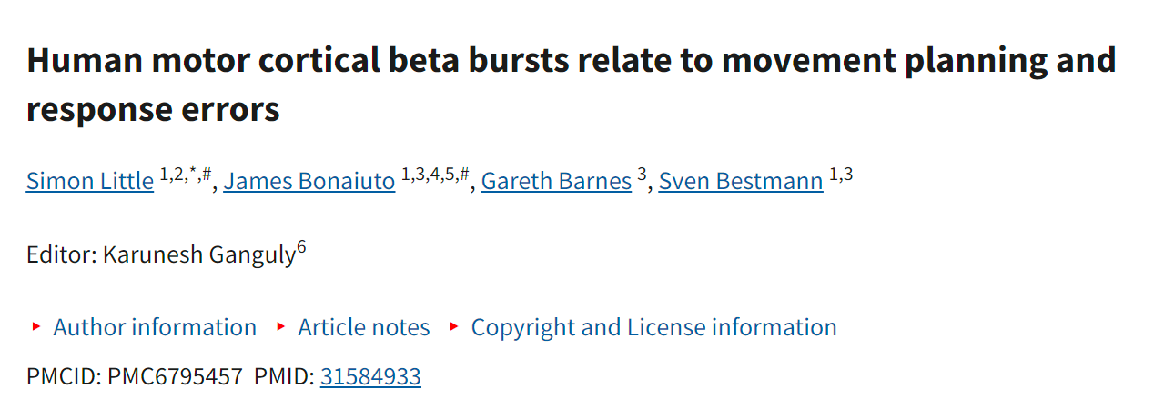
Next step: Partial bursts Lock (PBL)
Singal trail level
Pre response: transient bursts of beta activity occurred during movement preparation (Low coherence , slow response)
Post response (error *) : increased beta burst activity correlated with higher rates of response errors

